Slide 2
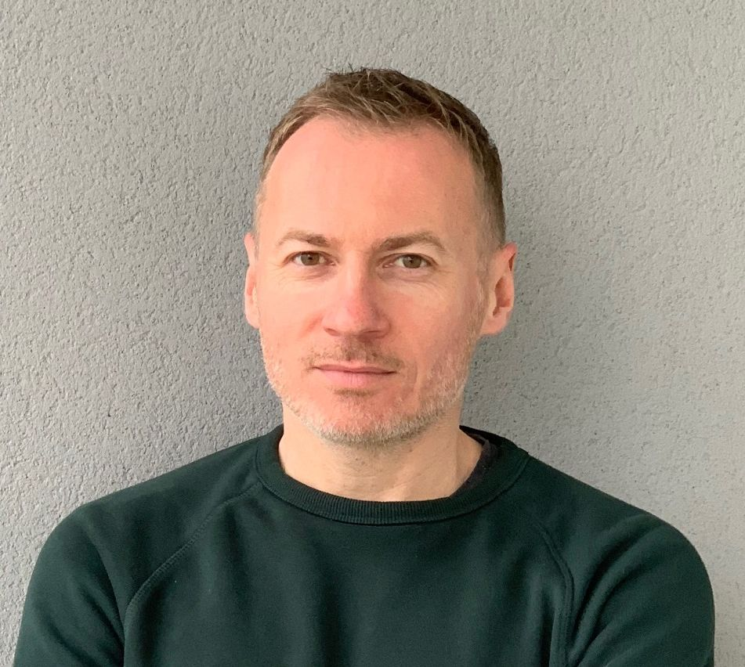
Speakers
Vincent Gouriou
GIS Specialist, Information department, Cedre
Pierre Daniel
Forecasting Operations Directorate, Marine and Oceanographic Forecasting Department, Météo- France

Slide 3
The Global Initiative for West, Central and Southern Africa (WACAF)
Launch in 2006
Objective
Enhance the capacity of States to prepare for and respond to oil spills, so they can better protect their marine and coastal environment
Technical assistance
National and subregional workshops
Trainings
Exercises
Conferences
Annual budget:
IMO
Ipieca : 6 O&G companies
Angola
Benin
Cabo Verde
Cameroon
Congo
Democratic Republic of Congo
Equatorial Guinea
Gabon
Ghana
Guinea
Guinea-Bissau
Ivory Coast
Liberia
Mauritania
Namibia
Nigeria
Sao Tome and Principe
Senegal
Sierra Leone
South Africa
The Gambia
Togo
Notes:
GI WACAF focuses on the Atlantic coast of Africa as you can see on the map and covers 22 countries. The main objective is to strengthen the capacity of the 22 partner countries to prepare for and respond to oil spills, to enable them to better protect their marine and coastal environment. To this end, we are implementing technical assistance activities. These activities consist of workshops, training (technical or legal) or table-top or deployment exercises.

Slide 4
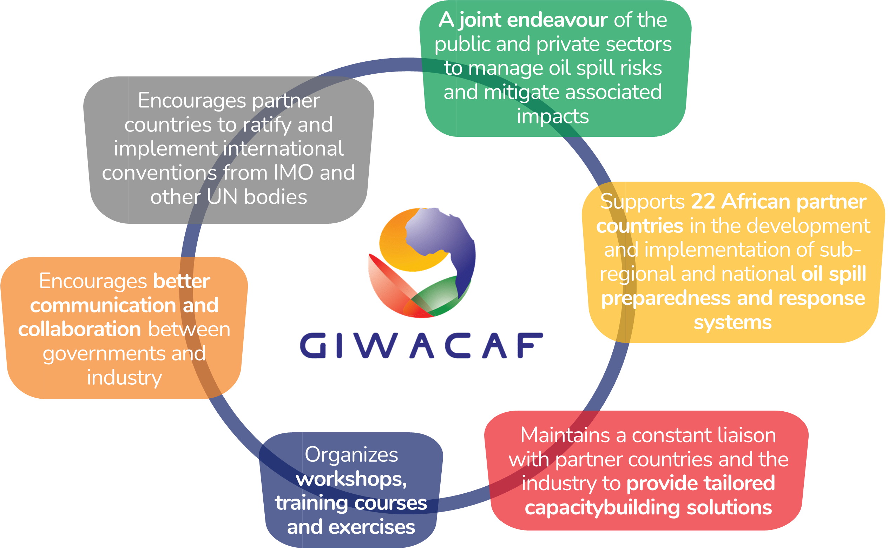
GI WACAF – OPRC Convention

Slide 5
Drift modelling in oil spill preparedness and response at sea
28/06/2023
Pierre DANIEL (Météo-France) / Vincent GOURIOU (Cedre)

Slide 6
Presentation outline
Purpose of modelling tools (weathering and transport)
What information do you need for modelling ? (input data)
What are the main categories of models ?
Example of models (commercial software / opensource / institutional)
Demonstration : MOTHY
Demonstration : WEBGNOME
Choice and comparison of models (eg. French prediction committee)
The keys elements : environmental data
Limitations on modelling use
How to make a MOTHY request in the framework of MPERSS
Summary and conclusion

Slide 7
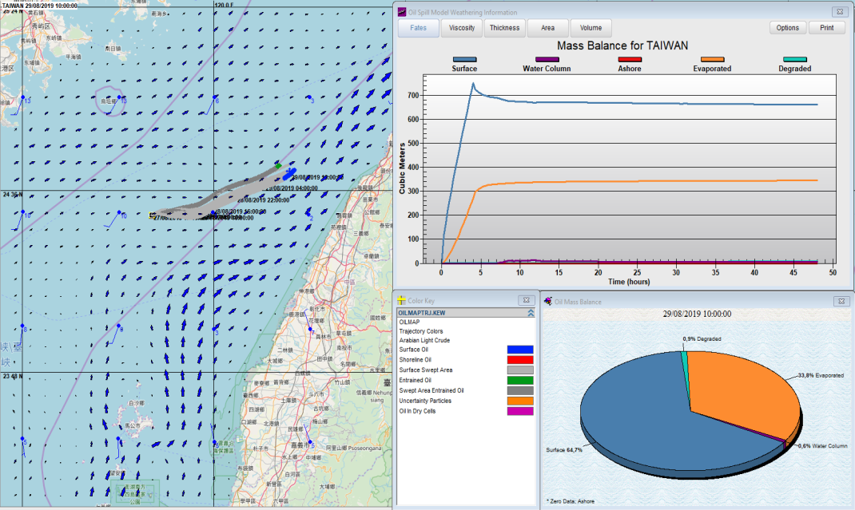
Purpose of modelling tools (weathering and transport)
In case of an accident at sea, with the aim of defining a strategy, you need to anticipate:
The behaviour of the oil (weathering)
The drift of oil slicks (trajectory). Impacted shoreline.
As soon as possible and then regularly (recalibration with aerial, satellite and buoys observations).
Oilmap modelling (oil drift and behaviour)

Slide 8
What information do you need for modelling ? (Input data)
Type of oil, properties (database)
If you don't know the type of oil, you can also run the model drift (if possible : fill in the density)
Winds and currents
In theory, oil moves at ± 3% of wind speed and 100 % of the current
In general, current is the most important parameter
Local, regional, global datasets
Wide variety of datasets through web servers / pay or free
Spill location, amount, etc.
Water temperature, salinity, sea state etc ...

Slide 9
What are the main categories of models / which uses ?
There are different types of models :
Oil weathering models and especially evaporation, emulsification, dispersion, evolution of viscosity and density. For study and real case.
Trajectory or deterministic models are used to predict the route of an oil slick over time. Mainly for real case.
Stochastic models, which are also known as probability models, show the probability of where an oil spill may impact for defined time periods. Mainly for study.
Backtracking models, reverse the trajectory modelling process. These can be used to estimate the spill origin in situations where the source or release point is unknown. Mainly for study.
Notes:
Oil weathering models predict the changes in oil characteristics that may occur over time, under the influence of a variety of environmental conditions.
Trajectory or deterministic models are used to predict the route of an oil slick over time.
Stochastic models, which are also known as probability models, show the probability of where an oil spill may impact for defined time periods. Historical wind records that contain the frequency of wind speed and direction are required.
Backtracking models, reverse the trajectory modelling process. These can be used to estimate the spill origin in situations where the source or release point is unknown.

Slide 10
What are the different models (software / opensource / institutional)
Software with licenses, developed by private companies : OILMAP (RPS), OSCAR (SINTEF), MIKE (DHI), OSIS (BMT) …
Opensource / free models / institutional :
WEBGNOME, ADIOS2 (NOAA, USA), online / worldwide
Opendrift (Norwegian Meteorological Institute, Norway), software / opensource / worldwide https://opendrift.github.io
MOTHY (Météo-France, France) in the framework of MPERSS, worldwide
WITOIL (CMCC, Italy), online / worldwide http://witoil.com/app.html
Notes:
WITOIL :
http://www.witoil.com/
Noosdrift :
https://odnature.naturalsciences.be/noosdrift/

Slide 11
OILMAP (RPS) - deterministic (real case and study)
OILMAP (RPS) provides predictions of the movement of spilled oil and its weathering
Notes:
You can see the spill and the drift until the strandings on the shoreline during 48 hours simulation, you can also see the weathering model results with mass balance (graphics)
The oil weathering model predicts the changes in oil characteristics that may occur over time, under the influence of a variety of environmental conditions

Slide 12
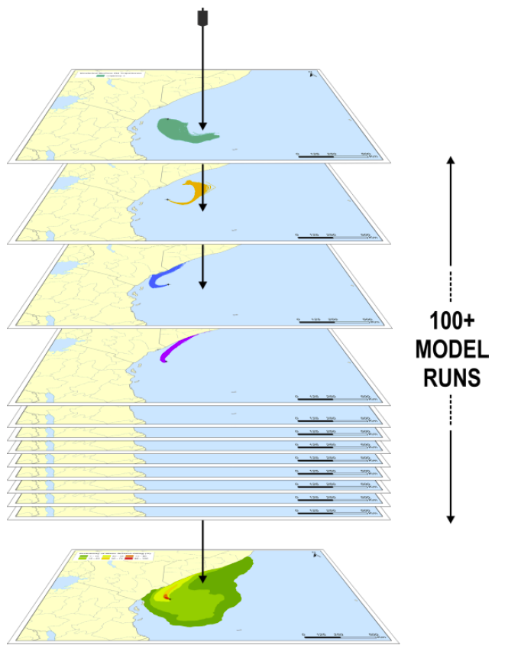
The use of ocean currents for oil spill monitoring
OILMAP (RPS) - stochastic (study)
Stochastic model
(combination of 500 runs)

Slide 13
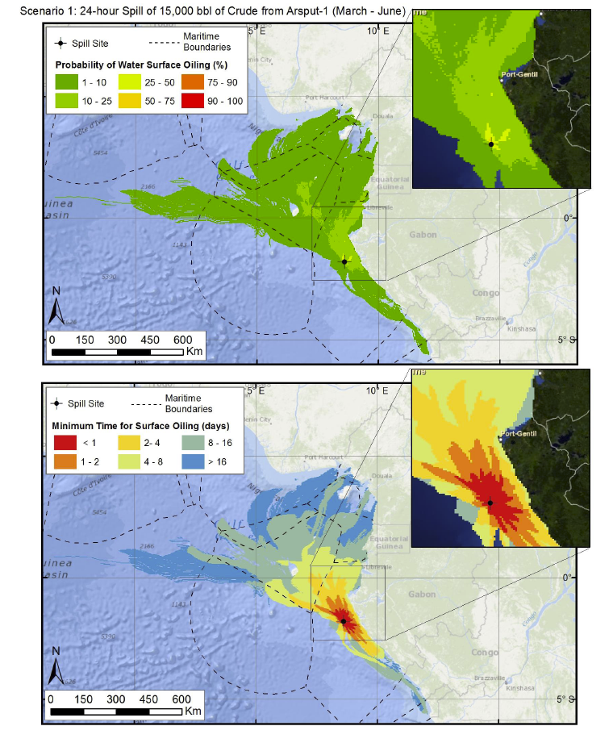
The use of ocean currents for oil spill monitoring
OILMAP (RPS) - stochastic (study)
Stochastic model
(combination of 500 runs)
Probability of presence of the slick regardless of time
Minimum time to reach the coast
Notes:
This is a combination of 500 runs which provide the probability and the minimum time to reach the coast. On this map : some scenarios forecast some strandings in less than 12 hours
Stochastic models or probability models shows the probability of where an oilspill may impact for defined period, Historical wind and current records that contain the frequency of wind speed and direction are required,

Slide 14
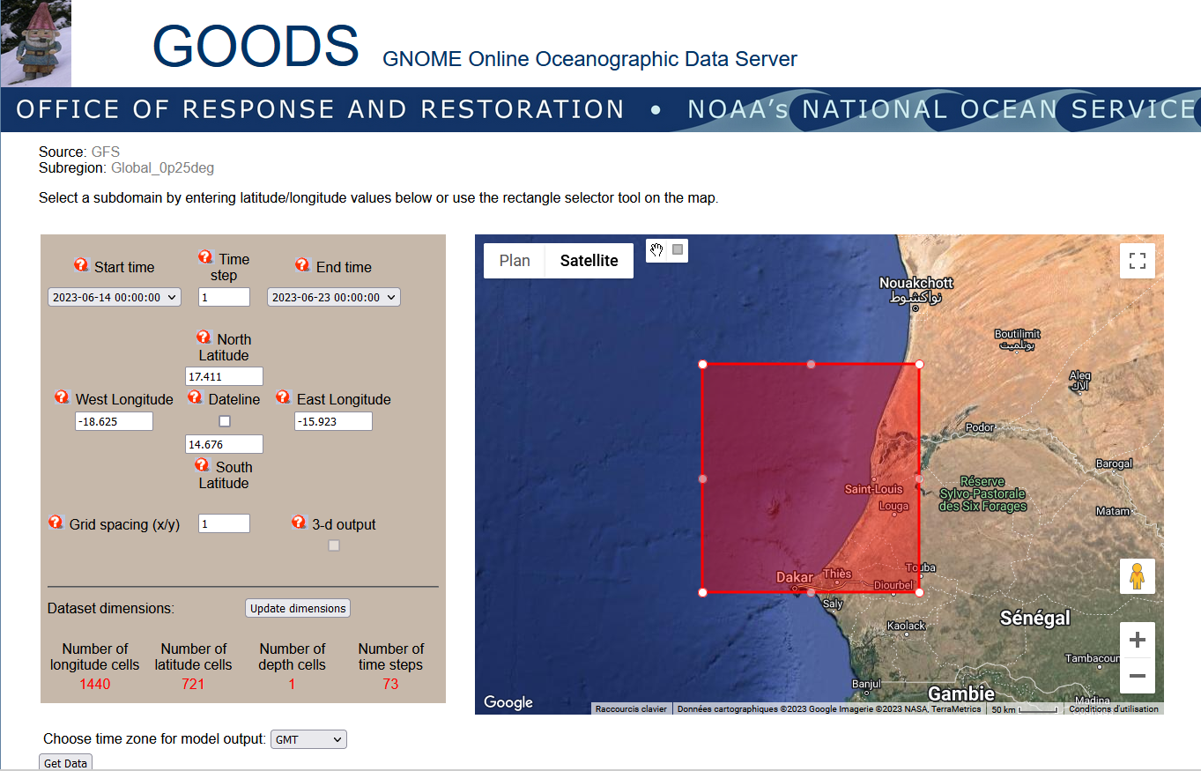
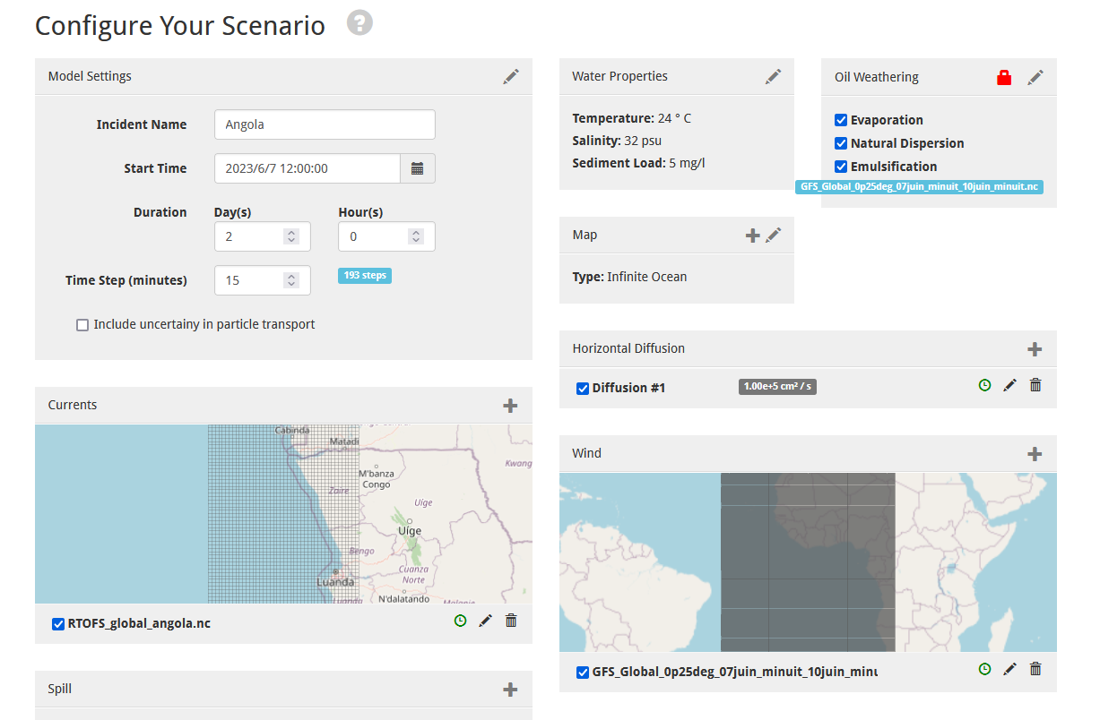
WEBGNOME (NOAA) (webgnome demonstration later)
WEBGNOME (NOAA) provides predictions of the movement of spilled oil and its weathering
1 - Download wind and current datasets : https://gnome.orr.noaa.gov/goods/
2 - Configure your scenario: https://gnome.orr.noaa.gov/ (manual setup)
1
2

Slide 15
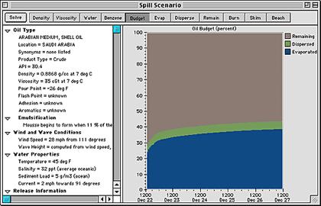
ADIOS 2 (NOAA) – weathering (webgnome demonstration later)
ADIOS Automated Data Inquiry for Oil Spills
Oil weathering model
NOAA (National Oceanic and Atmospheric Administration, USA)
FREE DOWNLOAD : http://response.restoration.noaa.gov/
Also available with Webgnome (cf. demonstration)

Slide 16
ADIOS 2 (NOAA) – weathering (webgnome demonstration later)
Output data :
Overall budget
Evaporation
Emulsification (water content)
Dispersion
Viscosity
Density
Benzene concentration in air

Slide 17
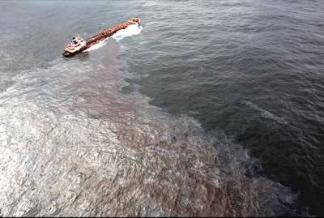
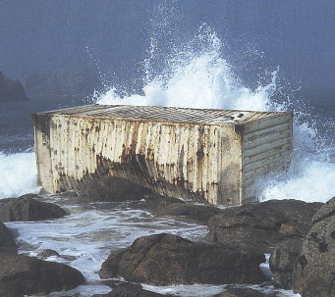
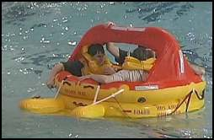
Drift forecasts at Météo-France
MOTHY system
Surface/subsurface drift of hydrocarbons
Since 1994
Cargo container drift
Since 1998
81 SAR targets
Since 2009
An emergency response service:
Response time < 30 min
H24 availability
Global response capacity

Slide 18
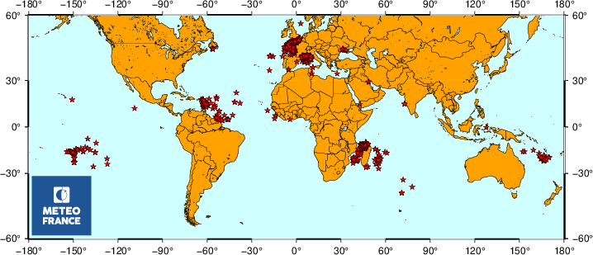
MOTHY drift forecasts
Over 1000 requests per year, 40 % for oil
2022
Over 1000 requests per year, 40 % for oil

Slide 19
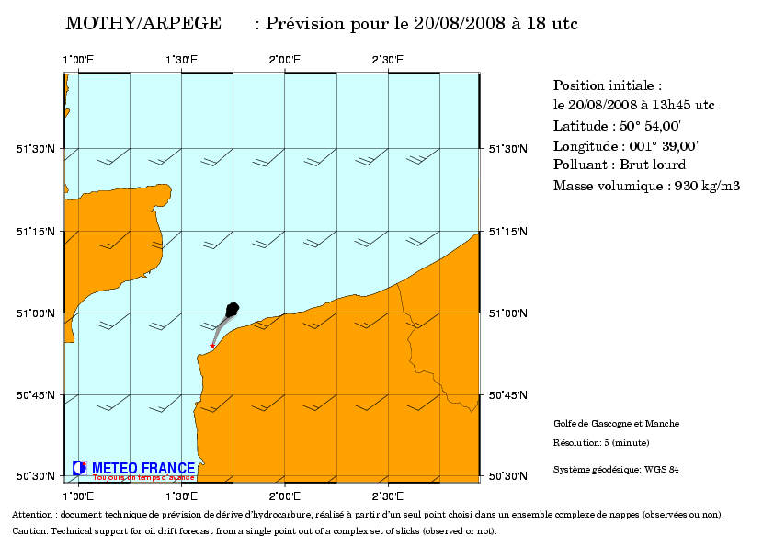
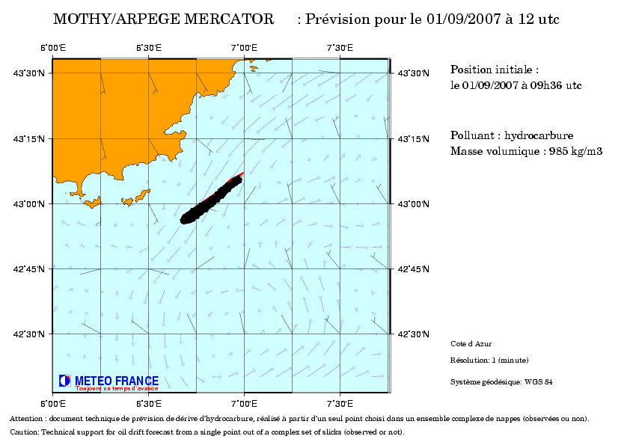
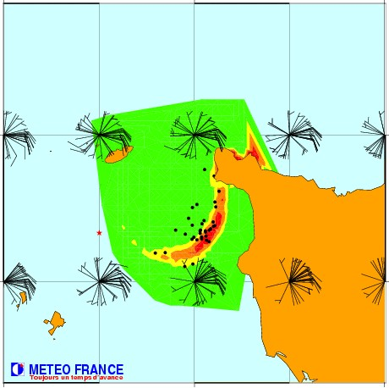
Oil drift forecasts examples

Slide 20
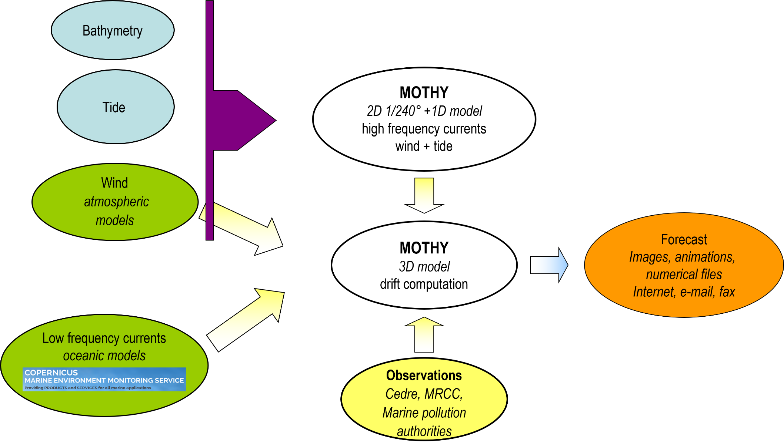
MOTHY system

Slide 21
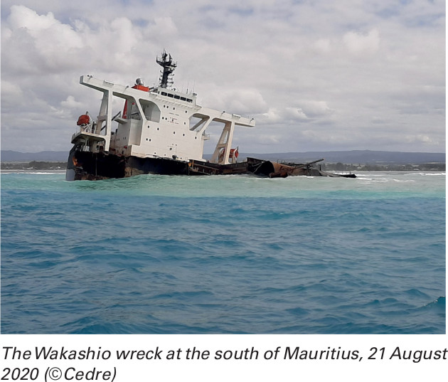
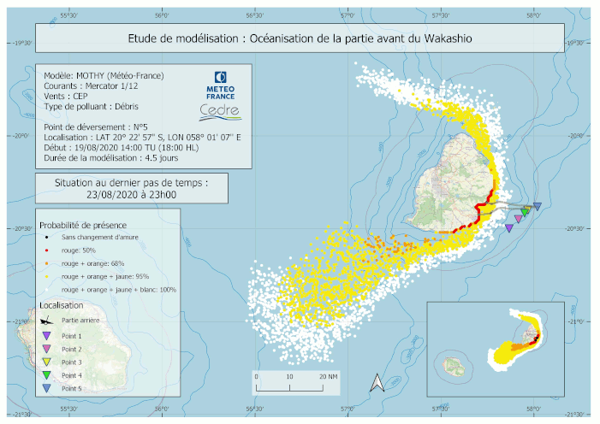
Latest significant incident around Africa
25 July 2020: grounding of the bulk carrier Wakashio on a reef in Mauritius
Risk assessment for Réunion Island, 200 km to the west

Slide 22
Additional features: backward drift
Searching for the origin of a pollution:
which wreck is leaking?
which ship has discharged gas?
where is the wreckage of the plane that crashed?
Examples :
EgyptAir flight 804 from Paris to Cairo crashed into the Mediterranean Sea on 19 May 2016.
Backward drifts of debris and kerozene were used to locate the wreckage.
This information was critical in determining the cause of the crash.

Slide 23
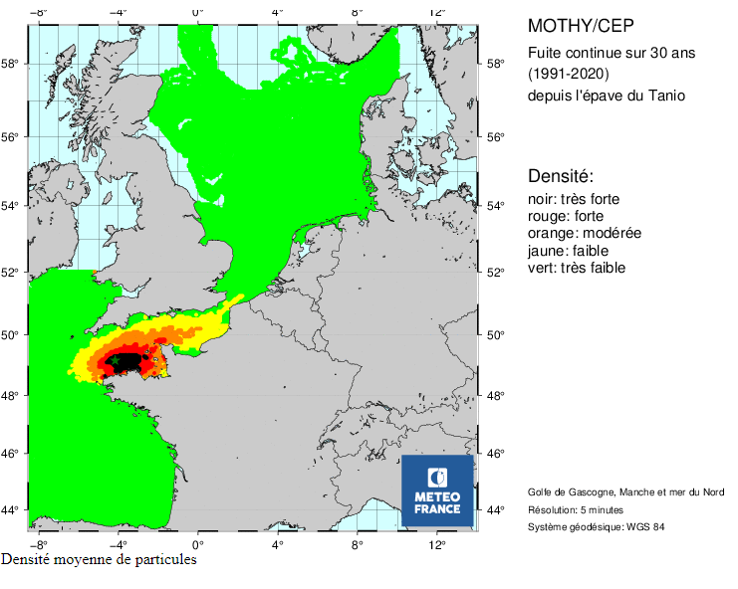
Additional features: statistical trajectory analysis
Given a specific spill location, where might it go and what might it harm?
Evaluate potential threats to sensitive locations from possible spill sites
Identify shoreline areas that are likely to be impacted
Calculate the likelihood of a certain amount of oil reach a given site within a specific timeframe
Estimate the impact of a spill on a particular resource
Analyze deficiencies in response personnel and equipment
Example :
Wreckage risk analysis with hourly release for 30 years: 262,980 trajectory simulations.

Slide 24
Quiz 1
(Quit full screen mode, check the chat !)

Slide 25
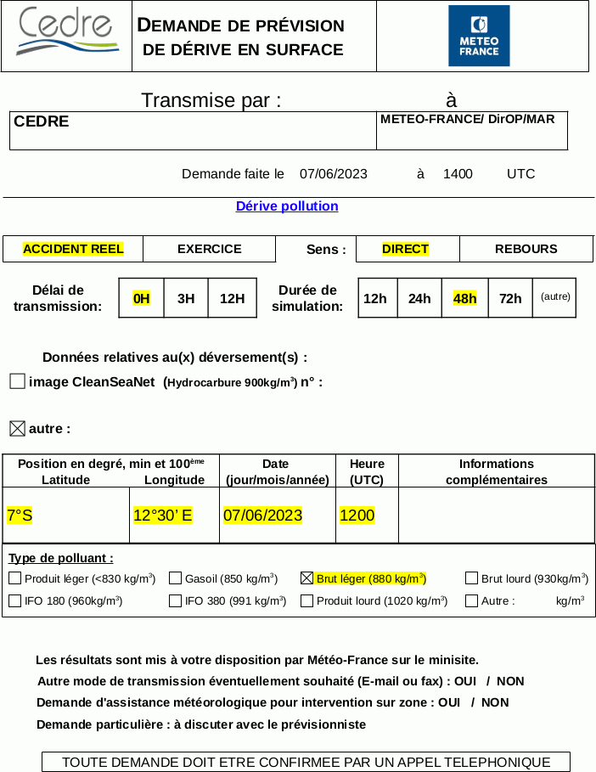
Demonstration (MOTHY) - Angola
Request by e-mail
Specific form
Phone confirmation

Slide 26
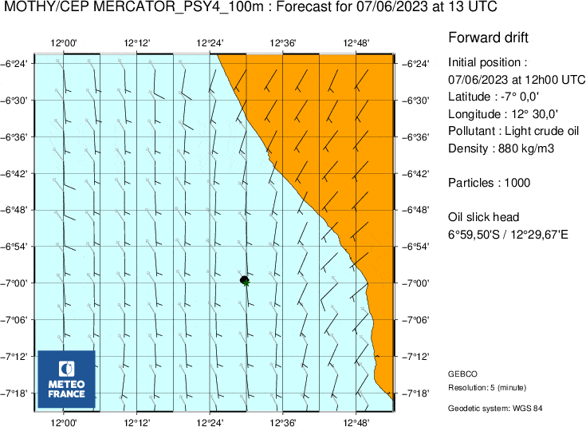
Demonstration (MOTHY) - Angola
Delivered on a dedicated website
Maps (GIF)
Animation (GIF)
Specific formats
KMZ
GPX
SHP

Slide 27
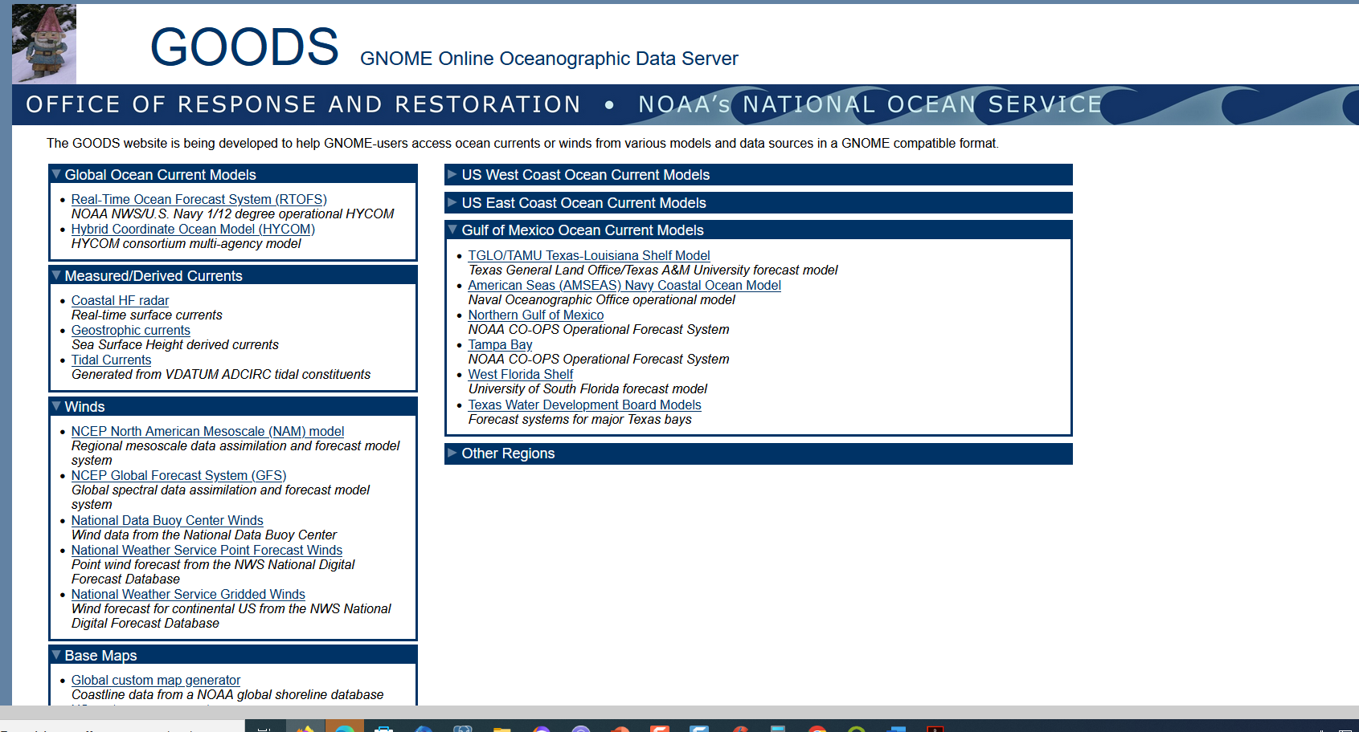
The use of ocean currents for oil spill monitoring
Demonstration (WEBGNOME)

Slide 28
The use of ocean currents for oil spill monitoring
Demonstration (WEBGNOME)
Possibility of using your own datasets

Slide 29
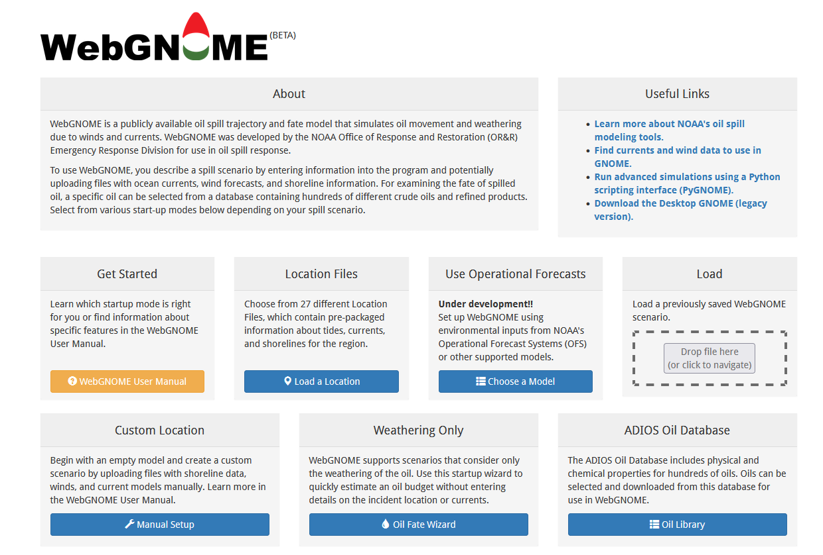
The use of ocean currents for oil spill monitoring
Demonstration (WEBGNOME)

Slide 30
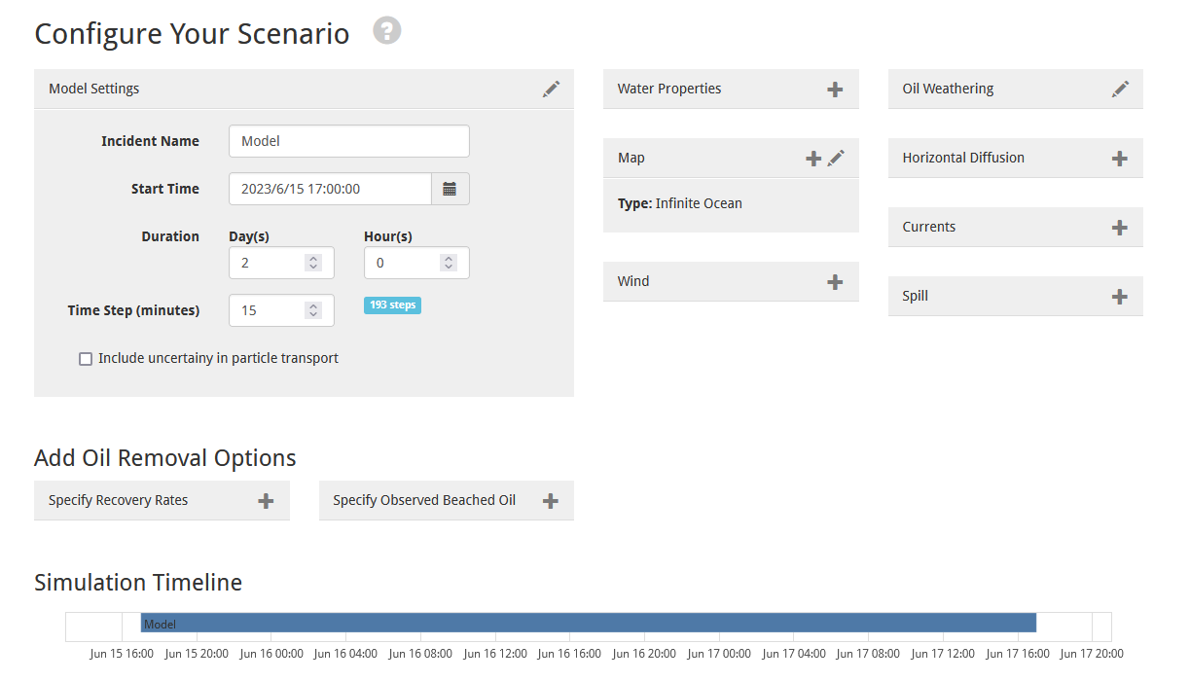
The use of ocean currents for oil spill monitoring
Demonstration (WEBGNOME)

Slide 31
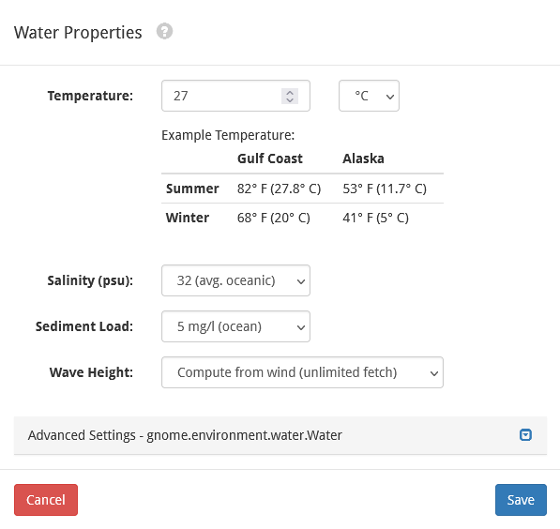
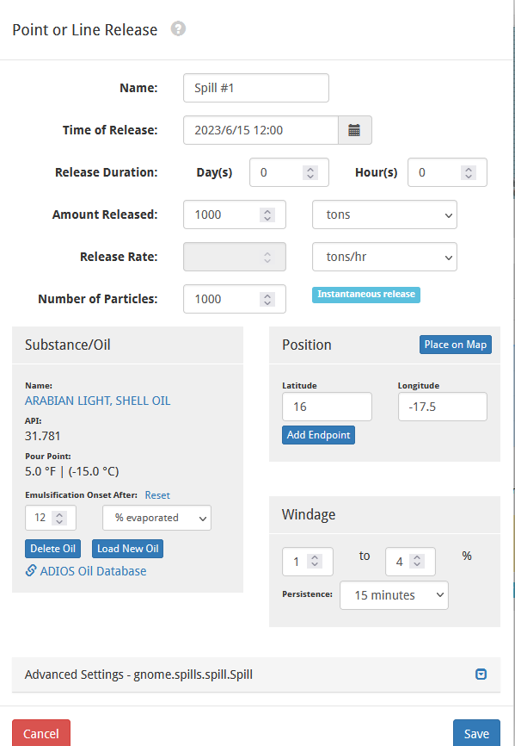
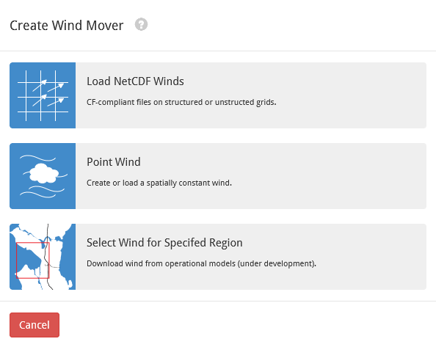
The use of ocean currents for oil spill monitoring
Demonstration (WEBGNOME)

Slide 32
The use of ocean currents for oil spill monitoring
Demonstration (WEBGNOME) - Angola

Slide 33
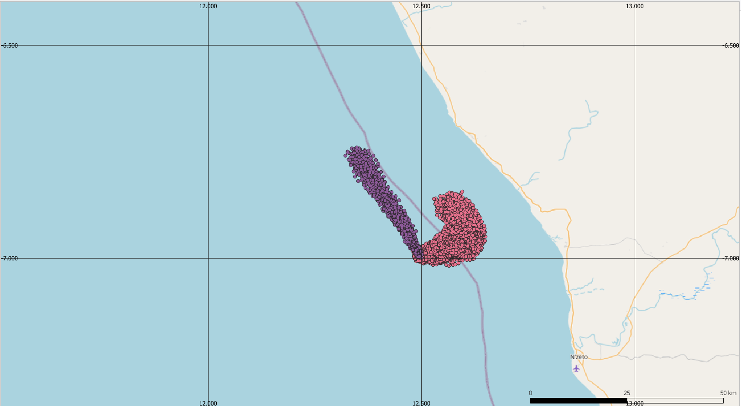
The use of ocean currents for oil spill monitoring
Webinaire ENG - Angola (MOTHY / WEBGNOME)
Scenario :
2023/06/15 12:00:00
1000 tons of Arabian light
Instantaneous spill
Location : 58 nautical miles from the Angola shoreline (7°S/12°30E)
Simulation duration : 48 h
Run with MOTHY (Météo-France). Winds : IFS / Currents : Copernicus
Run with Webgnome (NOAA). Winds GFS / Currents : HYCOM
MOTHY
WEBGNOME

Slide 34
The use of ocean currents for oil spill monitoring
Demonstration (WEBGNOME)

Slide 35
The use of ocean currents for oil spill monitoring
Choice and comparison of models (ex : French prediction committee)
French Monitoring and Prediction Committee (for oil and chemical spill) is composed of Cedre, Météo-France, Ifremer, National Hydrographic service (SHOM) and state action at sea.
Running and comparing the different models
Comparing the same transport model with different datasets
Comparing the transports models with each other
Analyse the crisis situation and data using every output available from model
Make operational recommendations
Produce a synthetic map for broadcasting
Sometimes : relationships with other countries (Prestige : Spain / France)
Notes:
The algorithms (oil drift calculation) may be different depending on the model
When there is a major incident as Prestige or Erika, a commitee with differents experts takes place every day
The committee runs differents model with different hydrodynamic input and then compares the results, then provides a common response to authorities, Sometimes : relationships with other countries (Prestige : Spain / France)
In that way and to respond to the challenge of a faster and better response, the secreteriat general of the sea create the drifting Committe on november 21 of 2002, during the prestige accident. This committee is a gathering of known scientists competent in oceanography, atmospheric dynamics and pollution domains. So during prestige it was composed of experts from Cedre, Meteo France, Ifremer, National Hydrographic service (SHOM) and state action at sea (which is in charge of managing the response at sea). The missions of the drifting committee are

Slide 36
The key element : environmental data / Ocean current models
FREE DATA : COPERNICUS https://marine.copernicus.eu/
Provider: CMEMS (Copernicus Marine Environment Monitoring Service)
Mercator PSY4 1/12° (GLOBAL Analysis Forecast Phy 001 024)
Available in webgnome :
Real-Time Ocean Forecast System (RTOFS) NOAA NWS/U.S. Navy 1/12 degree operational HYCOM)
Hybrid Coordinate Ocean Model (HYCOM) HYCOM consortium multi-agency model https://www.hycom.org/
PAID-FOR DATA :
SATOCEAN(1/12°) Provider: SAT-OCEAN / based on HYCOM https://www.sat-ocean.com/

Slide 37
The key element : environmental data / Atmospheric models
FREE DATA :
ARPEGE (1/10° & 1/2°)
Provider : Météo-France
Coverage: Europe + worldwide
https://donneespubliques.meteofrance.fr/
GFS (1/4°) available in webgnome
GLOBAL Forecast System
Provider: NOAA NCEP
National Centers for Environmental Prediction
https://www.nco.ncep.noaa.gov/pmb/products/gfs/
NAVGEM (1/2°)
Navy GLOBAL Environmental Model
Provider: U.S. Navy
https://www.hycom.org/dataserver/navgem
PAID-FOR DATA : IFS (1/8°)
ECMWF Integrated Forecasting System
Provider: European Centre for Medium-Range Weather Forecasts
Coverage: worldwide
https://www.ecmwf.int/en/forecasts
SAT-OCEAN (1/12°)
Provider: SAT-OCEAN
https://www.sat-ocean.com/

Slide 38
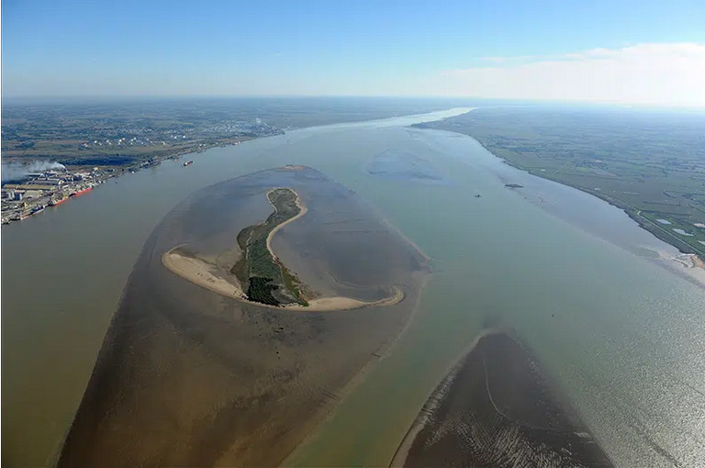
Limitation on modelling use / warning
Near the shoreline, a river, an estuary
In a harbour (specific study to create a complete current model, some weeks of work for oceanographers)
Waves, turbulences, gales, oil weathering, interacting currents, local currents, differences of temperatures….
Sometimes global currents are better than local currents

Slide 39
Marine Pollution Emergency Response Support System (MPERSS)
A system coordinated by the World Meteorological Organization (WMO)
In case of marine pollution emergency response operations :
Provision of meteorological and oceanographic information
Provision of drift forecasts
Area concerned :
Global
Same geographical distribution than those for the Global Maritime Distress and Safety System (GMDSS)
Outside waters under national juridiction
For national waters at the request of the relevant countries

Slide 40
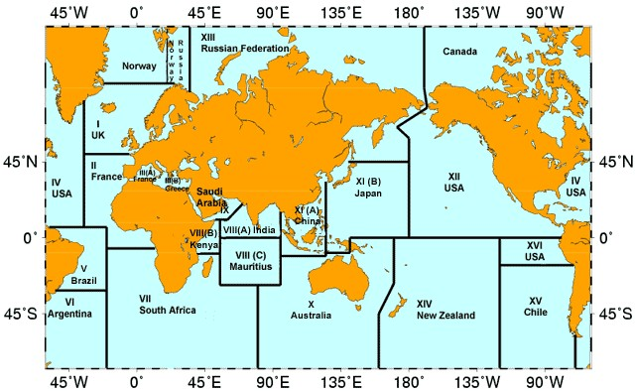
MPERSS & GI WACAF area
Assistance provided by:
France over area II (from Mauritania to DRC)
South Africa over area VII (Angola, Namibia and South Africa)

Slide 41
How to make a request in the framework of MPERSS ?
You provide your national meteorological service with the details of the marine pollution incident.
The national meteorological service :
Contact the Area Meteorological and Oceanographic Coordinator (AMOC)
Either the French meteorological service (Météo-France)
Or the South African Weather Service
There is a specific procedure for this.
The AMOC then provides forecasts of oil slick drift.

Slide 42
Quiz 2
(Quit full screen mode, check the chat !)

Slide 43
Summary and conclusion
WEBGNOME
Datasets : https://gnome.orr.noaa.gov/goods/
Configure your scenario: https://gnome.orr.noaa.gov/
ADIOS2 : http://response.restoration.noaa.gov/
MPERSS / MOTHY (http://www.meteorologie.eu.org/mothy/)
Tools exist, are useful provided you consider their limits
Not magic, maths
Validation on real cases
Validation with buoys drifts / aerial and satellite observations
Compare different models
Discussions and expertise

